Slide 1
C29PE Economics for Professionals
Week 11 –
Part 1: The supply side alternative and growth
Sloman et al., 2023, Chapter 31
Part 2: The External Economy
Sloman et al., 2023, Chapter 24, 25, 27

Slide 2
References
Sloman et al (2023)
  Chapter 31.1 – 31.3
  Box 31.1
  Chapter 27.1 – 27.4
  Box 27.4
  Chapter 24.1 – 24.4
  Boxes 24.1 & 24.2
  Chapter 25.1 – 25.3
Important!
  The PowerPoint slide deck for Week 9 lecture provides a guideline of the topics you need to know. However, the materials in the slide deck are insufficient if you wish to excel in the course
  To do well, please do not forget to read the relevant sections of the core textbook
  Please also ensure that you follow economics news regularly as these sources could be used as examples to supplement your answers during assessments

Slide 3
Session Aims
To introduce and explore supply side policies
To understand the nature of balance of payments and exchange rate
To discuss trade theories and the concepts of absolute advantage and comparative advantage

Slide 4
Part 1: Supply side policies

Slide 5
Supply Side Policy Aims
Supply means productive capacity – related to long-run growth
  Considered demand side policy – response to short-run fluctuations
  Supply-side policy shifts short-run and long-run AS curves to the right
Shifts of aggregate supply to the right is related to improvements in productivity
  Increase GDP/hours worked
  Increase GDP/worker
Question is – how can productivity be improved?
Notes:
2

Slide 6
Productivity in selected economies, 2020 (UK = 100)
Problem only appears large when
comparing UK with USA on basis of
output per workers
That may need some explanation
Note: Figures are current-price GDP per hour worked/person employed
Source: Based on data in OECDStat (OECD, 2022)

Slide 7
Supply-side policies and long-term growth
P
LRAS₁
LRAS₂
SRAS₁
SRAS₂
Supply-side policy results in a rise in aggregate supply
a
b
P₁
For price stability, demand increases match supply increases
AD₂
AD₁
Y_{p1}
Y_{p2}
Y

Slide 8
Labour markets and productivity
Turning towards policies to address perceived problems
  Might greater labour mobility reduce unemployment?
    Many elements to labour market flexibility: wage setting, union representation, employment law – may reduce ability of labour market to respond to shocks
  Would greater investment improve productivity?
    Education is investment – but need physical capital to utilise it fully
    How do we encourage entrepreneurship and risk-taking?
    How do we turn (scientific) knowledge into useful good and services?
Notes:
2

Slide 9
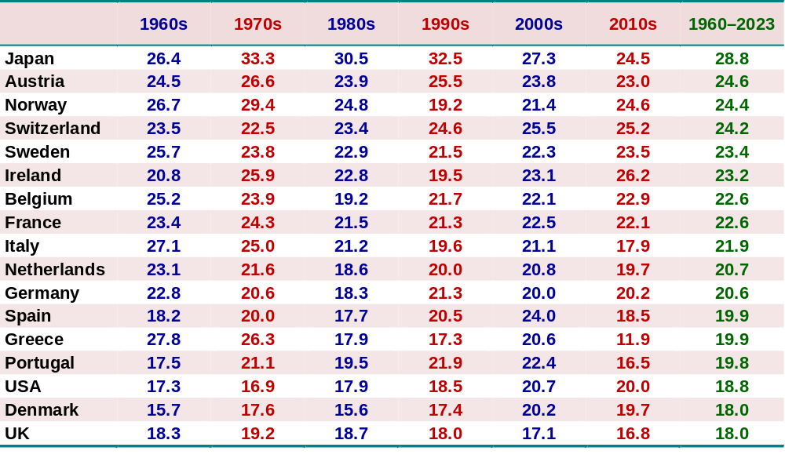
Gross fixed capital formation as a percentage of GDP
Source: AMECO database, European Commission, DGECFIN, Tables 3.2 and 6.1 (data from 2022 based on forecasts)

Slide 10
Policy approaches
Market orientation – free up markets
  Reduce regulations seen as impeding wage flexibility
  Encourage creation of knowledge spill-overs
    Accelerate diffusion of useful knowledge through the economy
May suggest a more interventionist approach
  Spillovers are positive externalities – think of policies discussed in week 7: subsidies, direct spending, tax reliefs, regulation
Suggests that supply-side policies affect aggregate demand
  Education, training, R&D – even regulation – comes with demand-side effects
Notes:
2

Slide 11
Market orientation
Simplest formulation: government does less, markets do more
  Reducing government spending, taxation – in that order
  Argument that private sector has more incentive to achieve allocative efficiency, develop innovations than government bureaucracy
    Smaller state role with low tax increases incentives for private sector to find efficiency
Notes:
4

Slide 12
Market-orientation (2): role of tax cuts
Taxes typically on income, employment, expenditure
  Reducing income tax should affect labour supply
  Expect to see wealth (income) and substitution effects –
    Higher pay means spending targets easier to achieve
    Cost of effort offset – substitution effect should offset wealth effect
    May encourage workers to enter employment – labour force increases
    Reduces costs to employers, increasing employment
  Expect similar effects of cuts in corporate taxes
    Lower profit taxes should lead to higher output (so MC = MR)
    Tax relief for investment leads to income and substitution effects
Notes:
4

Slide 13
Supply-side Policies: encouraging competition
Policies have developed since 1980s
  Wave of privatisation and deregulation – e.g. financial services, airlines
  Introducing market relationships into the public sector
    Allow public service managers to bid for autonomy in spending
    Public–private partnerships - Private Finance Initiative (PFI and PFI2) in UK
    Infrastructure (schools, hospitals) built on Build, Own, Operate, Transfer basis
Notes:
6

Slide 14
Interventions on supply-side
Go back to market failure argument –
  Government better able to assume complex risks than private sector
  Spillovers from knowledge development give public sector coordination role
Government has ability to take on ownership of businesses
  But also create public R&D institutions (e.g. with universities)
    Human capital has a very important role to play
  Support private sector R&D through tax relief, subsidies, advice
Notes:
11

Slide 15
General government expenditure (% of GDP)
Notes: Data from 2018 based on forecasts
Source: Based on data from World Economic Outlook Database (IMF, April 2022) and AMECO database (EC. May 2022)
Notes:
15

Slide 16
Gross expenditure on R&D (% of GDP)
Note: OECD = 38 members (as of 25 May 2021) of the Organisation for Economic Co-operation and Development.
Source: Gross Domestic Spending on R&D (OECD, 2022)

Slide 17
Part 2: The external economy

Slide 18
Balance of payments
A set of accounts that shows the flow of money between residents of a country and the rest of the world
Component accounts
  Current account - Records all sales of currently produced goods and services, investment incomes and income transfers
  Capital account – Records flow of funds for purchase/disposal of fixed assets such as land, intangible assets (trademark, patents), payment of grants by governments for oversea projects, debt forgiveness by government and receipt of money for capital projects
  Financial account – Records purchase and sales of financial assets
If inflow exceeds outflow, the account is in surplus; if outflow > inflow the account is in deficit
Double entry principle - Transactions enter BOP twice, once as debit and once as credit → Sum of account positions must lead to a ‘0’ (BOP is balanced)

Slide 19
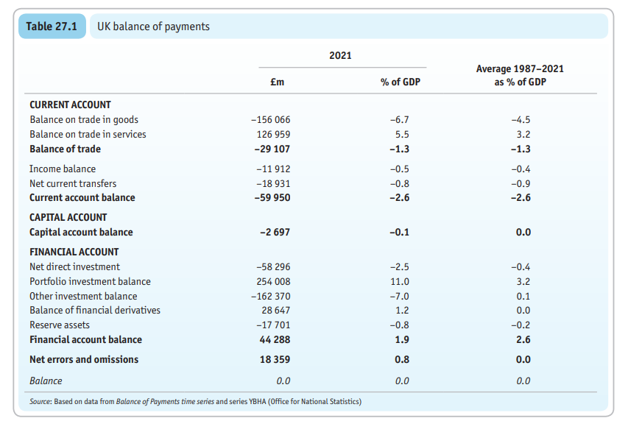
UK’s balance of payments at a glance

Slide 20
Current and Capital Accounts
Part of national accounts:
  Setting out a country’s external position relative to rest of the world
  Consists of current account, capital account, financial account
Current account: payments for exports, imports
  trade in goods and services – balance of trade in goods and services
  then add income flows (e.g. wages, dividends), monetary transfers (remittances) to obtain balance on current account
Capital account: a small balance representing
  Net flow of funds into country from purchase of assets, transfers, and capital accumulation

Slide 21
The Financial Account
Formerly the ‘capital account’ – relates to asset accumulation
  Balance represents net financial inflows because of investments being made, including
    Foreign direct investment – by organisations based in other countries
    Purchase of financial securities by investors in other countries
    Bank deposits and other short-term financial flows
    Government’s use of reserves to support currency exchange rates
Sum of balances of current, capital, financial account should add up to zero
  For each credit, there should be a debit
  But generally need (quite large) balancing item for errors, omissions

Slide 22
UK balance of payments as a percentage of GDP
Source: Based on data from Balance of Payments time series and series YBHA (ONS)

Slide 23
Trade theories
Why do countries trade goods and services? To understand trade, we explore 2 concepts, absolute advantage and comparative advantage
Absolute advantage occurs when a country can produce more of a good than another country with similar resources.
If Kenya can produce coffee with fewer resources than Canada, Kenya has an absolute advantage in coffee.
If Canada can produce cars with fewer resources than Kenya, Canada has an absolute advantage in cars.
Both countries will gain if Kenya specialises in the production of coffee and Canada in the production of cars, as the total production of coffee and cars will be at a maximum this way.

Slide 24
Comparative advantage
 | Tractors | Rice
Country A | 100 | 1000
Country B | 50 | 750
TOTAL | 150 | 1750
One country may be more efficient in producing all goods than another, but different relative efficiencies mean gains from trade can still be made.
Two Countries, A and B have the following production data for Tractors and Rice. Each country has 10 resources and devotes half of these resources (5 resources) to each.
Total production is 150 Tractors and 1750 tonnes of Rice.

Slide 25
Country A has a greater advantage in Tractors, as it can make twice as many as Country B from the same resources, the advantage is 100:50 or 2:1.
Country A also has an advantage in Rice over Country B, this time the advantage is 1000:750 or 1.33:1.
Let us now look at domestic opportunity cost ratios.
For Country A the ‘cost’ of 1 Tractor is 1000/100 = 10 tonnes of Rice.
For Country B the cost of 1 Tractor is 750/50 = 15 tonnes of Rice.
For Country A the ‘cost’ of 1 ton of Rice = 100/1000 = one-tenth of a tractor.
For Country B the ‘cost’ of 1 ton of Rice = 50/750 = one-fifteenth of a tractor.
In terms of the opportunity cost (the amount of tractors given up for one ton of Rice), Rice is cheaper in Country B than in Country A.
Country B therefore has a comparative advantage in Rice.
Country A and Country B may trade based on this comparative advantage. What happens if each country ‘specialises’ so that Country A produces Tractors and Country B Rice?

Slide 26
 | Tractors | Rice
Country A | 200 | 0
Country B | 0 | 1500
TOTAL | 200 | 1500
Country A would be able to produce 200 tractors which is an increase of 50 over the original total for both countries. But Country B will only be able to produce 1500 tonnes of Rice. This is a reduction in Rice production and therefore not a great solution!

Slide 27
Gains from trade
By only partially specialising Country A, the more efficient country can have more of ‘both goods’ if for example Country A devotes 8 resources to tractors and 2 to Rice while Country B specialises fully in Rice:
We now have an increased total of both Tractors and Rice. We have a gain from trade!
 | Tractors | Rice
Country A | 160 | 400
Country B | 0 | 1500
TOTAL | 160 | 1900

Slide 28
Exchange Rates
The rate of exchange: how much of one currency required to purchase a unit of another currency
  e.g. the number of ringgit required to purchase a pound (about 6))
    In most countries, units of home currency per unit of foreign currency
    But in UK units of foreign currency per pound
Use foreign currency to make purchases, but also in trading
  Individual rates of exchange between pairs of currency driven by trading activity in short run
  Distinguish nominal exchange rates – based on trading from real rates
    Based on terms of trade – ratio of price levels for exports and imports
    Country with low inflation benefits from improving terms of trade:
    exchange rate appreciates
Notes:
4

Slide 29
Sterling exchange rates against selected currencies
Notes: (i) Index is the broad-based effective sterling exchange rate index; (ii) The euro was introduced in 1999, with notes and coins circulating from 2001. The euro figures prior to 1999 (in grey) are projections backwards in time based on the average exchange rates of the currencies that made up the euro.
Source: Based on data in Statistical Interactive Database (Bank of England)

Slide 30
Sterling nominal and real exchange rate indices
(Jan 1970 = 100)
Which country had the lower
inflation, especially in the 1970s?
Note: Exchange rate indices are BIS narrow indices comprising 27 countries; re-based by the authors, Jan 1970 = 100
Source: Based on data from effective exchange rate indices (Bank for International Settlements)

Slide 31
Theory of exchange rate determination
Exchange rate is a price – so apply principles of supply, demand
  Determine equilibrium exchange rate so that quantity demanded
  (of sterling) in USA equal to quantity supplied (in exchange for dollars)
  Excess supply (of sterling) pushes exchange rate down
    Excess demand (for sterling) pushes exchange rate up
  As an exercise think about the demand and supply for dollars
Can apply analysis of shifts in demand, supply in the same way
  Increased supply of sterling (buying more US goods and services?)
    Supply curve shifts to the right; quantity traded increases, exchange rate falls
  Reduced demand for sterling (UK interest rates expected to fall?)
    Demand curve shifts to the right; quantity traded falls, exchange rate falls

Slide 32
Determination of the rate of exchange
Supply of sterling
by UK
Excess supply of pounds leads to a depreciation.
b
a
$ price of £
Shortage of pounds leads to an appreciation.
d
c
Demand for sterling
by USA
Q of £

Slide 33
Floating exchange rates: movement to a new equilibrium
S₁
S₂
€ / £
D₁
D₂
Q of £

Slide 34
What causes exchange rates to vary?
Think of sterling depreciating (falling) against US dollar
  Must be less demand for sterling relative to US dollars
Several possibilities
  Reduction in demand for UK exports /
  increase in supply of US exports
    Would naturally follow rising UK income relative to USA
  Expectation of higher inflation in the UK; or lower (real) interest rates
  Belief that US offers superior investment returns –
  leading to flow of capital into USA
  Self-fulfilling beliefs – especially likely in trading:
    Keynes’ beauty contest story

Slide 35

Causes of a depreciation in own currency
(assume no changes abroad)
S₁
fall in interest rate
rise in inflation rate
rise in aggregate demand
inward investment less attractive
speculation against depreciation
S₂
€ / £
D₁
D₂
Q of £
Notes:
35

Slide 36
Exchange Rates and the Balance of Payments
Without government or central bank intervention
  a floating exchange rate: determined by supply, demand factors
  automatic balancing of overall balance of payments
  current, capital and financial accounts may not separately balance
With government or central bank intervention
  Reducing short-term fluctuations
    selling foreign currency, increasing demand for sterling, possibly funded by borrowing (e.g. from IMF); or using interest rates actively
  Fixed rate of exchange over the longer term requires
    Aggregate demand management; or use of import controls
    Perhaps with additional supply-side policies

Slide 37
Fixed versus Floating Exchange Rates (1)
Advantages of fixed exchange rates
  Certainty – limiting speculation (if rate is absolutely fixed)
  Constrains government policies, ensuring ‘sound money’
Disadvantages of fixed exchange rates
  conflicts between exchange-rate and other macroeconomic objectives
    external factors may cause exchange rate to change
    maintaining currency value could require large changes in AD following interest rate changes
  problems of international liquidity – sufficient for trade, not so much as to cause inflation
  difficulties in adjusting to shocks – may require inappropriate deflation
    Will lead to speculation that regime might change ….
Notes:
9

Slide 38
Fixed versus Floating Exchange Rates (2)
Advantages of free-floating rates
  Treating exchange rate as a price – allows maximum freedom for domestic policy stance, including AD management
But exchange rates are then unstable
  speculation and overshooting – in response to ‘news’
  uncertainty for business – can be managed through forward markets
  lack of discipline on economy
Notes:
11

Slide 39
The reality: difficult to agree to fixed rates
Exchange rates are typically volatile – see box 27.4
  Monetary policy natural affects exchange rates through use of interest rates, credit availability
    Some governments therefore target exchange rates as part of policy
Must take account of growth in international financial flows
  Trade and international investment (a relatively small component)
  Much more important is market for foreign currency
    Impossible to insulate country from speculation against any fixed rate, except through international cooperation
  Governments have little power to prevent exchange rate fluctuations
    Can reach agreements such as Euro – establishing a currency
    Has experienced two major crises, which threatened its collapse

Slide 40
Summary
Supply side policies aim to increase productivity.
Effect of a rise in productivity is a shift in SRAS and LRAS to the right
Productivity increase can be made either with government intervention or market orientation – each approach has pros and cons; either approaches involve an increase in investments in skills, training, education and R&D and encourage more entrepreneurship, innovation and risk-taking
Balance of payments record the flow of funds between people in a country and the rest of the world. For organised record keeping, the fund flows are organised into various accounts
Balance of payments tend to balance or reach ‘0’ – net inflow and outflow balances out
Comparative advantage can explain why countries trade, and the gains from trade
Exchange rates reflect the relative value of a country’s currency as compared to a benchmark country currency. Fluctuations in exchange rates reflect changes in demand and supply conditions in the foreign exchange markets

Slide 41
Supplementary slides for reading (will not be covered in class)
UK’s productivity problems

Slide 42
UK’s problems emerged in the run-up to the financial crisis
Note: Figures are constant-price GDP per hour worked
Source: Based on data in OECDStat (OECD, 2022)
Notes:
42

Slide 43
And involve relatively small losses in productivity since then
Note: Figures are current-price GDP per hour worked
Source: Based on data in OECDStat (OECD, 2022)

Slide 44
UK capital stock and growth
Need to increase the scale of output – capital accumulation
  Increase labour productivity so that wages rise
Requires investment in capital (physical, human, organisational)
  Currently seen as a policy problem that the UK has a long record of low investment in physical capital
  And this explains relatively poor record of labour productivity
    Measure this by economic value created per hour of work (GDP/working time)
Is there a composition as well as a growth problem?
  Note physical stocks tiny compared with human capital – see box 26.4
  UK capital formation weak compared with other economies
  2/5 of stock consists of housing – not contributing to GDP
Notes:
2

Slide 45
Growth in capital and output per worker: 1961–2023
Ireland
Japan
Portugal
Finland
Spain
France
Greece
Belgium
Italy
Austria
UK
Denmark
Sweden
Netherlands
USA
Luxembourg
Switzerland
Note: Data from 2021 are forecasts; output and net capital are measured at constant prices.
Source: Based on data from AMECO database (European Commission).
Notes:
45

Slide 46
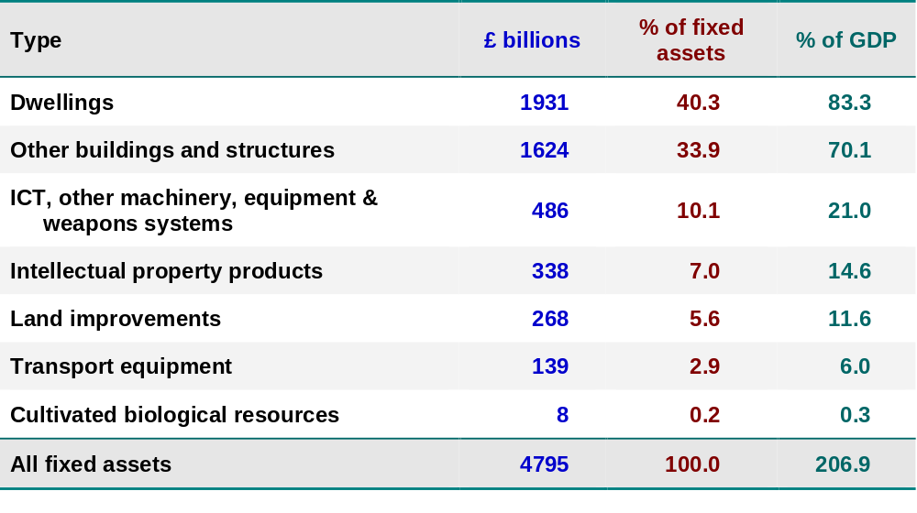
UK net capital stock, 2021
Sources: Based on data from Capital stocks and fixed capital consumption time series and series YBHA (ONS)

